Slide 1

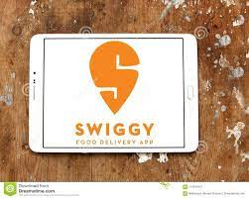
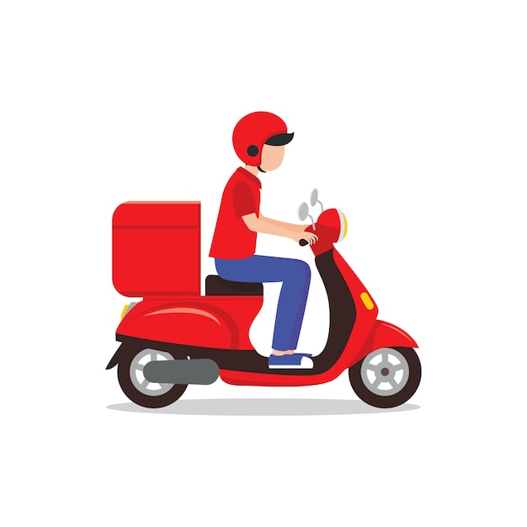
Swiggy Food Delivery Analysis
Project by:-
Prakash Khatri
Priya Bhardwaj
Bojja Manikanta
Manikyam Someshwar

Slide 2

Swiggy
Swiggy is an online food ordering and delivery platform founded in Bangalore, India in 2014.
Swiggy Food marketplace served customers through the length and breadth of India.
Customers can order food from a variety of restaurants and cuisines through the Swiggy app or website at their doorsteps.

Slide 3
Objectives :-
To extract the data from one of the leading online food delivery company swiggy.
Analysing the data of various aspects like area wise restaurant details,cousines offered by them, price,rating.
Extracting some meaningfull insights which can help to build future scope for the new players to enter the market.
To the data in such a way like that it can be scaled in the real time analysis to have more accurate predictions.

Slide 4
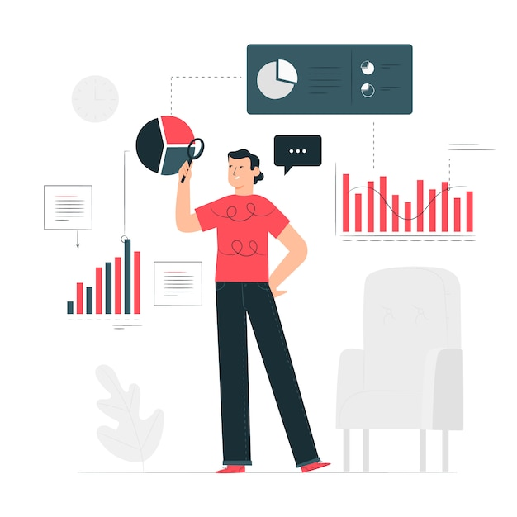
Insights

Slide 5
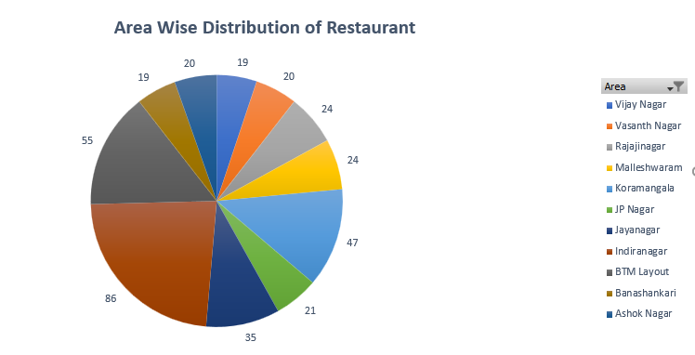
Area Wise Distribution of Restaurants :-
Area with a maximum occupancy of restaurants
Indiranagar- 16%
BTM Layout -10%
Koramangala-9%

Slide 6
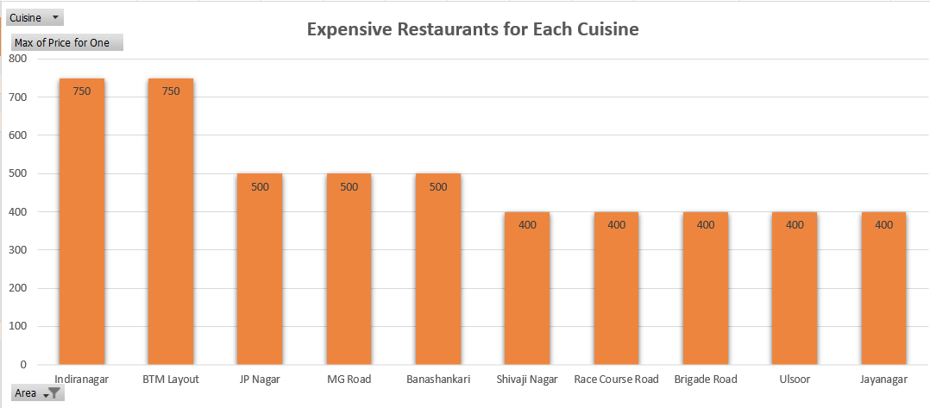
Expensive Restaurants for Each Cuisine

Slide 7
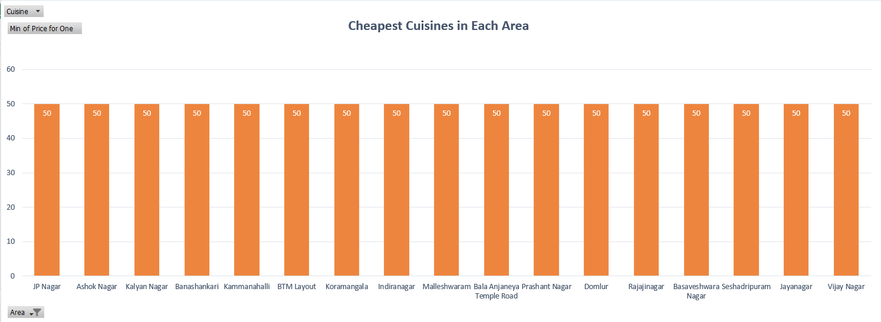
Cheapest Restaurants for Each Cuisine

Slide 8
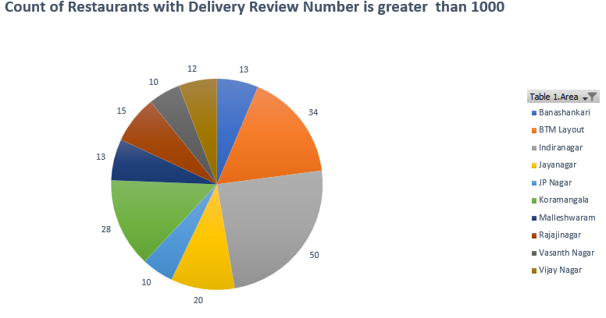
Areas With Maximum Restaurants with Delivery Review Number Greater Than 1000
Indiranagar- 50
BTM Layout-34
Koramangala-28

Slide 9
Delivery Time Vs Rating
Correlation between Delivery Time and Ratings: -0.495
This clearly says that as delivery time increases, ratings tend to decrease.

Slide 10
Areas With Maximum Number of Less Rated Restaurants
*It is assumed that a rating below 3.5 is the lowest

Slide 11
Area Wise Expensive Restaurants

Slide 12
Area Wise Cheapest Restaurants

Slide 13
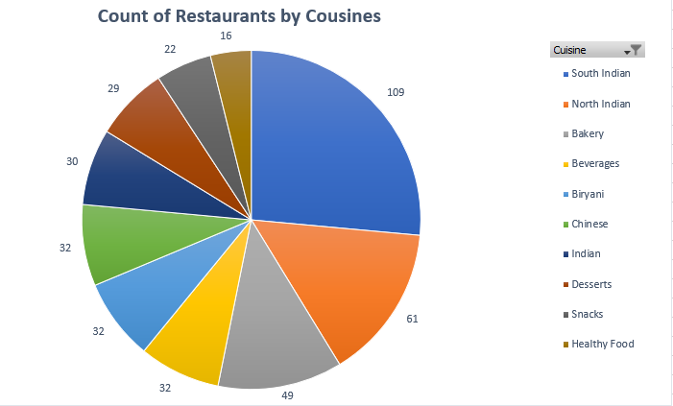
Number of restaurants for each type of cuisine

Slide 14
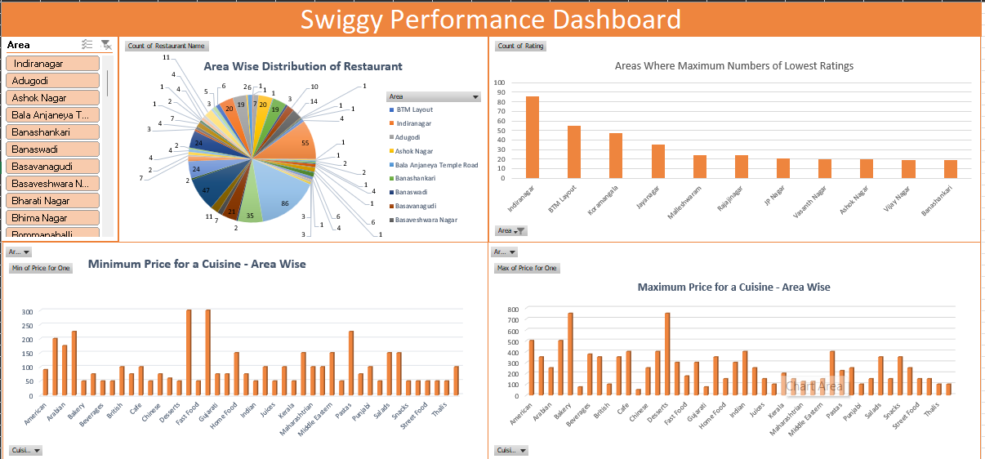
Dashboard :-

Slide 15
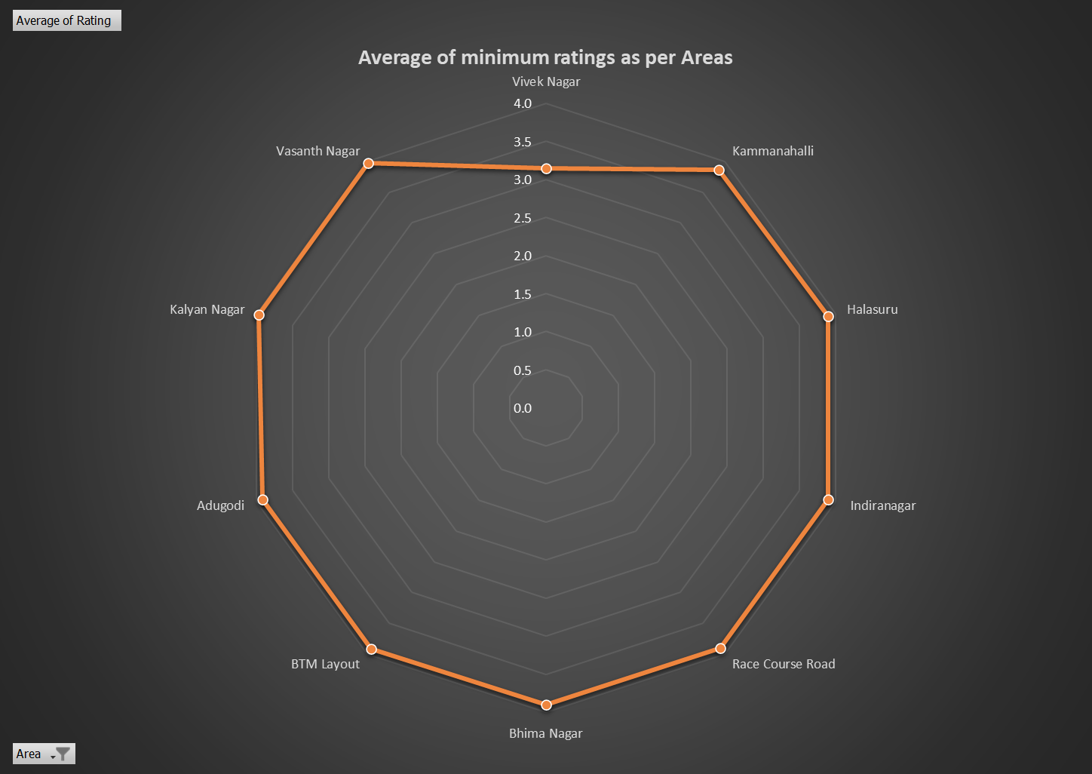
Future Scope
Suitable Location for Remote Kitchen :-
The average ratings of restaurants in Vivek Nagar are the lowest , but the number of people reviewing is high.
People in the area must be looking for good quality and tasty food.
The average ratings of restaurants in Vivek Nagar are the lowest.

Slide 16

Challenges
Dynamicity of Swiggy Website
Limited knowledge of HTML
Time Management
Data Scrapping

Slide 17

Learning Outcomes
Data Scrapping
Python libraries- BeautifulSoup, Selenium
Working in Team
Effective Time Management

Slide 18
Thank You

